Slide 2

Basho Technologies
Consistency, Eventually

Slide 4



2¹⁶⁰
0
Node 2
Node 1
PUT “cowboy”
2¹⁶⁰/2
Node 3
Node 4
Notes:
--

Slide 5


Notes:
-- let’s say LWW / timestamp

Slide 6
what did I store?
Notes:
--

Slide 7
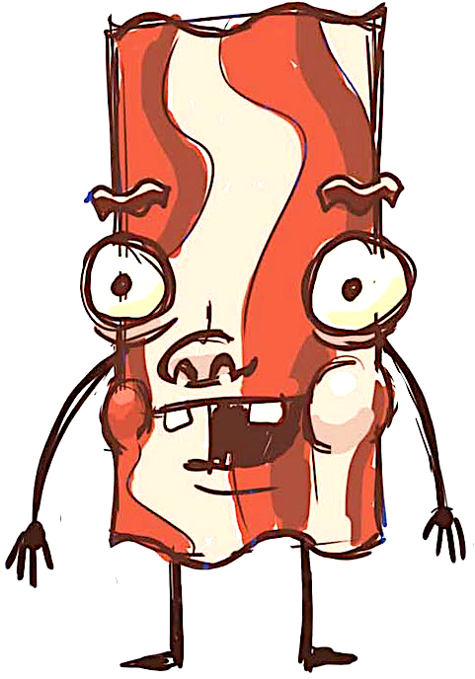
what did I store?
repair
Notes:
- Read repair

Slide 8
Read-Repair

Slide 10

making a list
checking it twice
Notes:
--

Slide 11
what did I store?
Notes:
--

Slide 12
Active Anti-Entropy

Slide 14
Consistency, Eventually
Notes:
- replication, read repair, siblings, quorums

